Slide 1



PrimeQA: Making multilingual information access via Question Answering Research easily available & replicable https://github.com/primeqa/primeqa
Notes:
Thanks for the intro. Since this is a short focus talk., I’ll be brief and to the point. I’m going to talk about an open source repo that one can use to quickly replicate the latest greatest in multiingual QA and also share their code for the community to move the SOTA for multilingual QA forward easily.

Slide 2
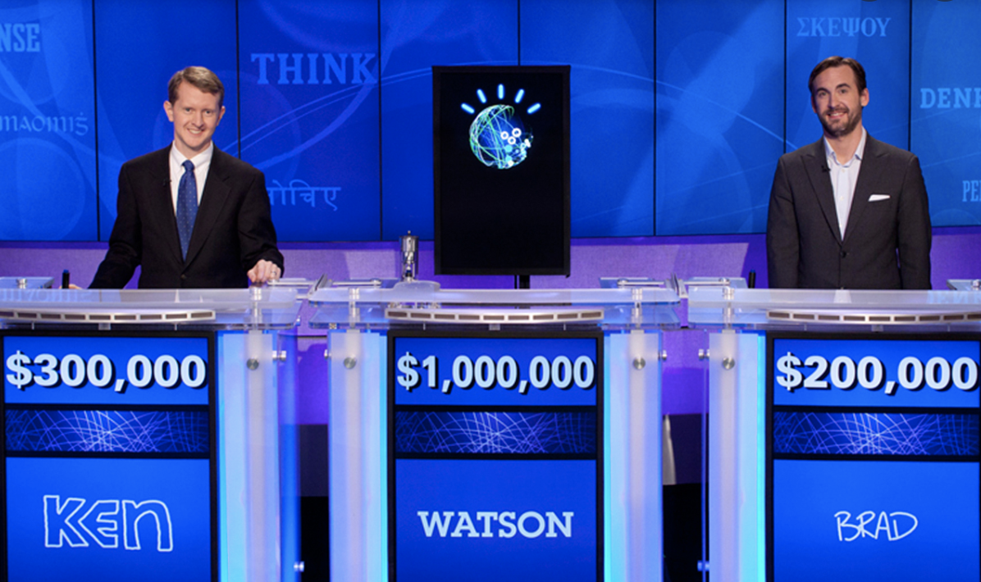
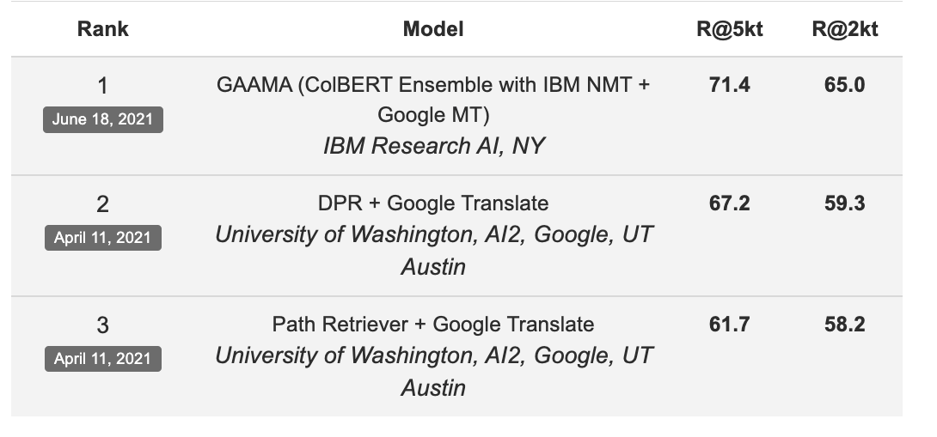
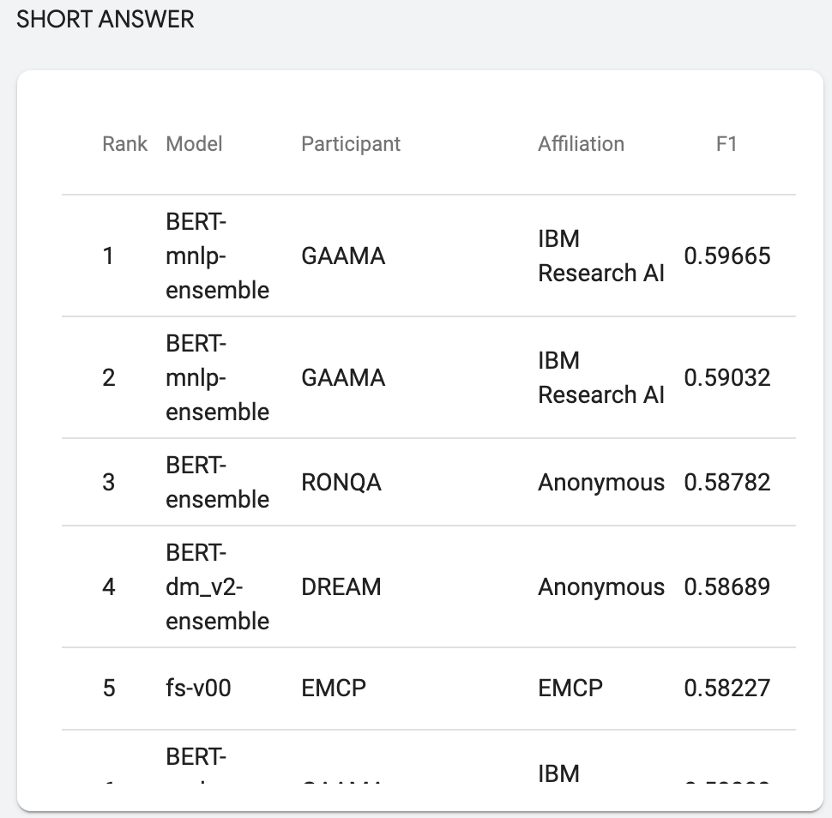

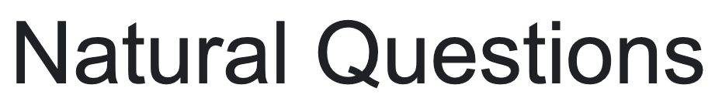

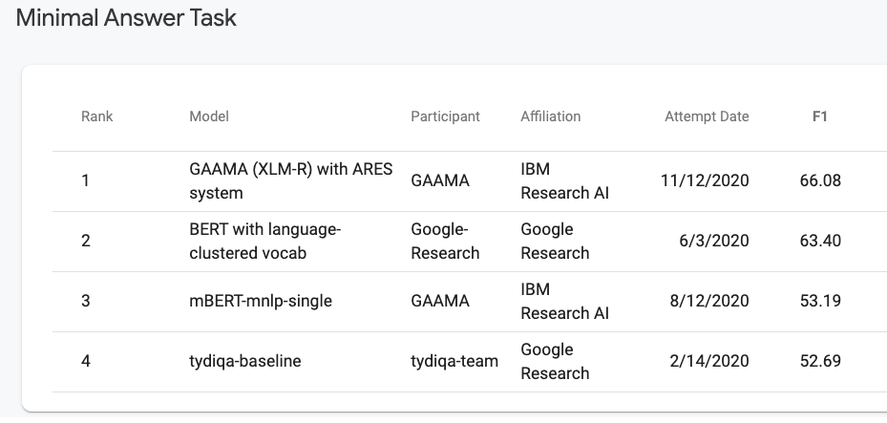

Question Answering milestones at IBM Research AI
2021-2022
2011
2011
2020
2019
Notes:
Here’re some QA milestones within my team that I manage at IBM research AI. The team is pretty advanced – we won jeopardy in 2011 and ever since we’ve matured and obtained top scores in multiple leaderboards.

Slide 3
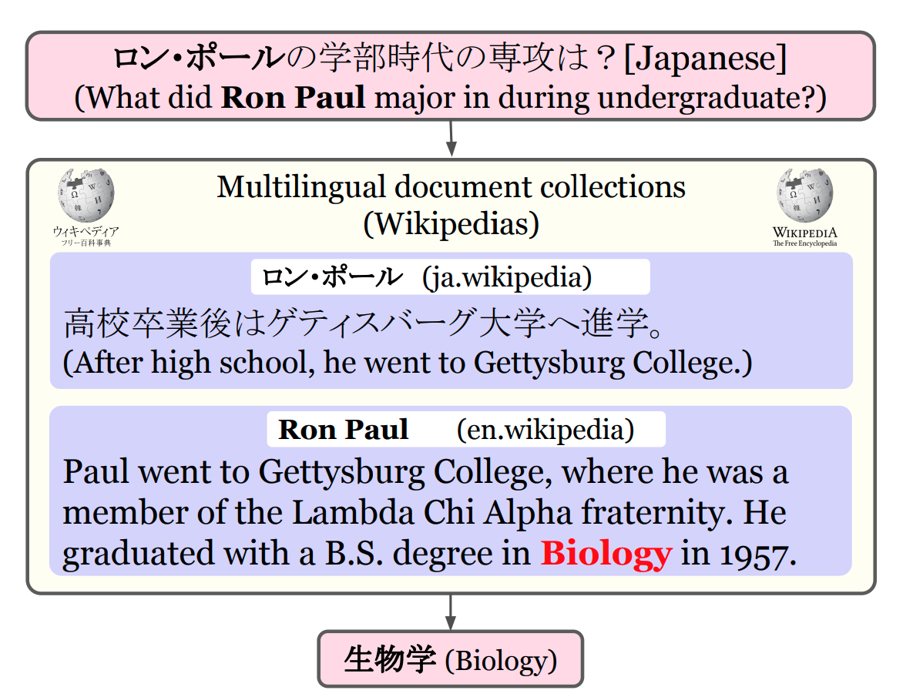
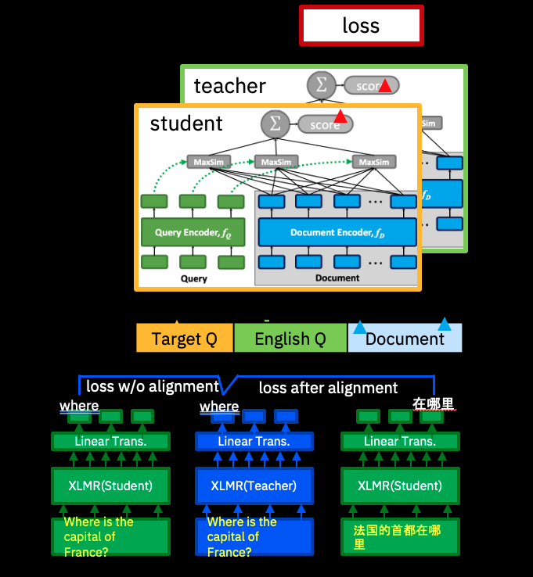
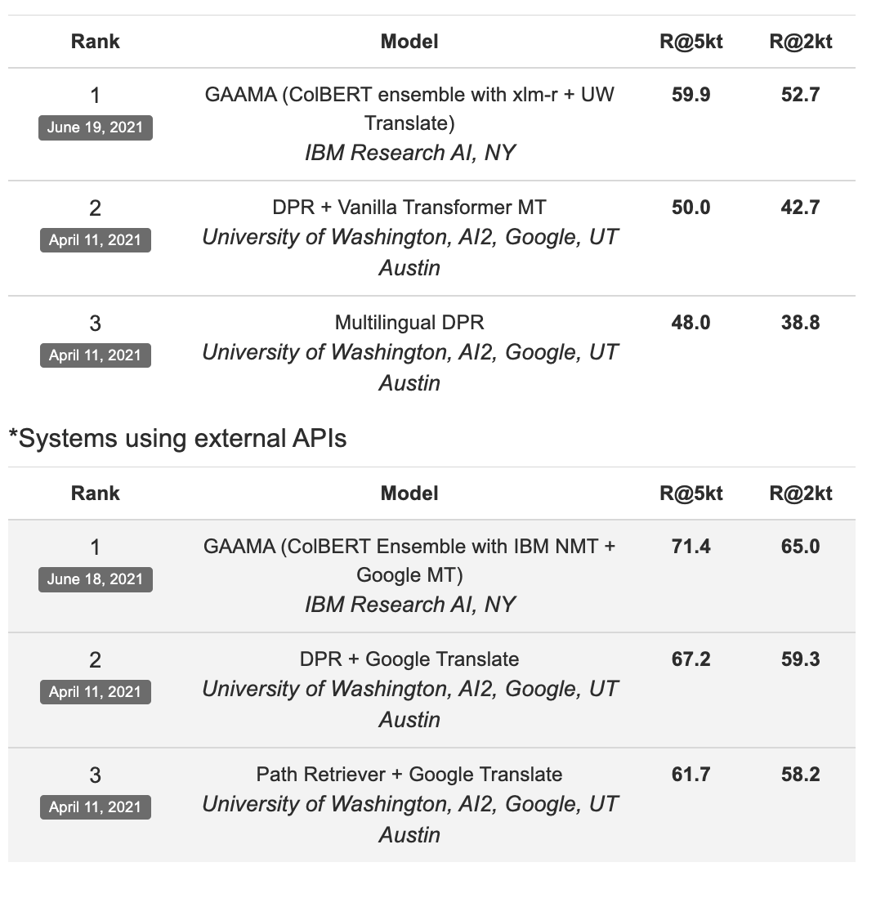
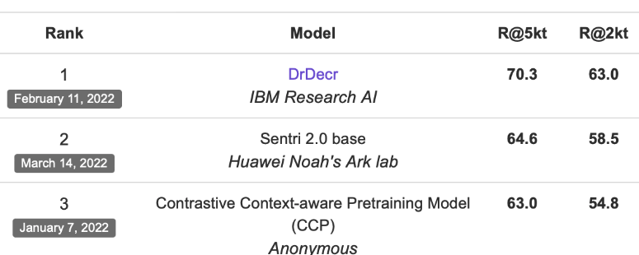
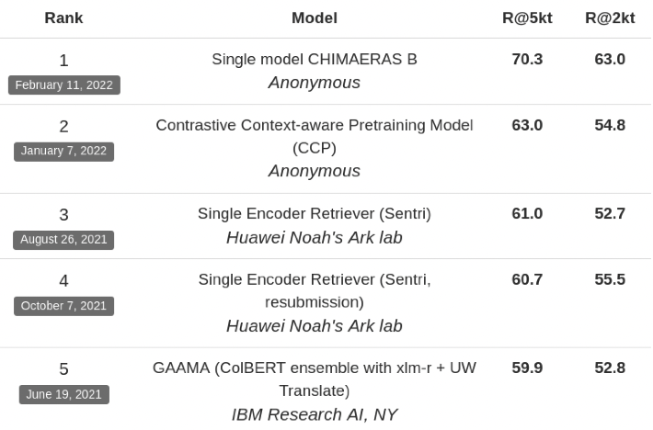

Cross-lingual Information Retrieval
Dr. Decr [Li et al. Learning Cross-Lingual IR from an English Retriever. NAACL2022]
Public vs Private api: -10pts
Public vs Private api: -1pts
Knowledge distillation helps
Top position in the leaderboard
Notes:
Build a cross lingual model from a purely Engish retriever and hhence no need for transaltion during inference.

Slide 4
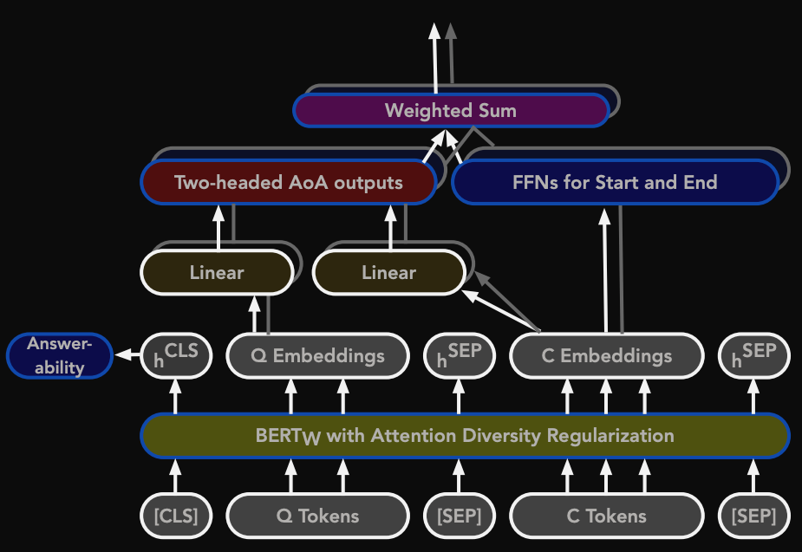
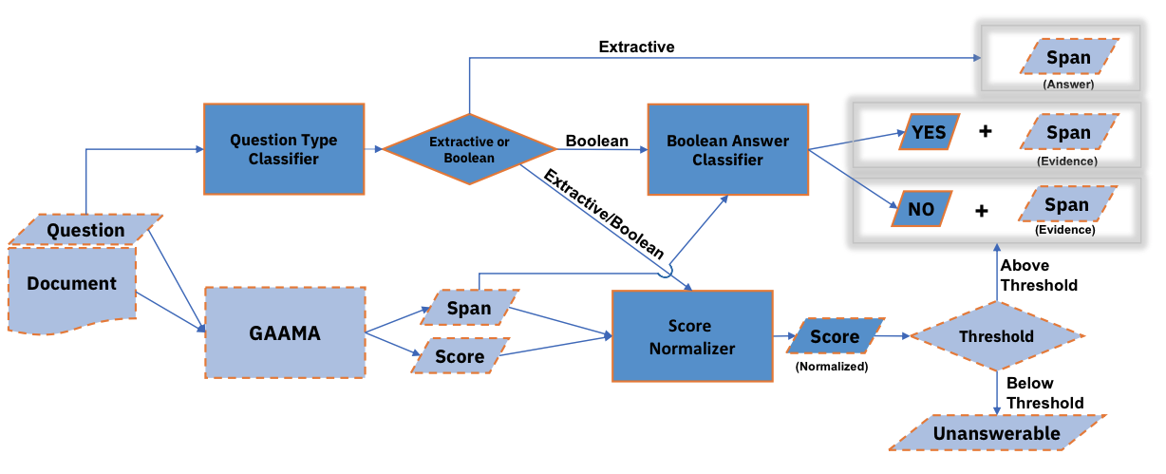
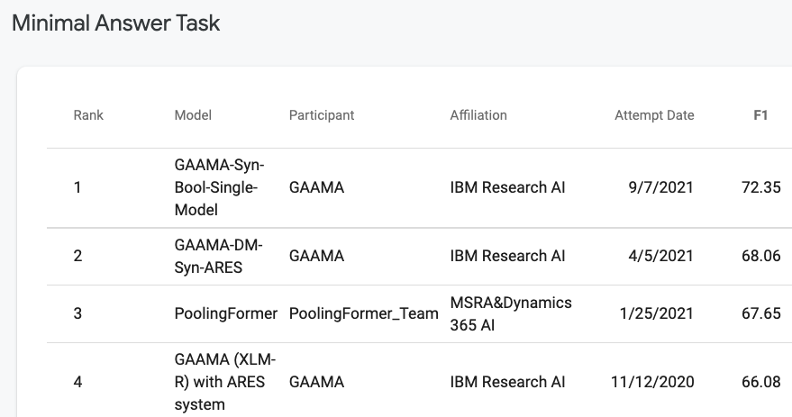
Multilingual Machine Reading Comprehension
Answering Boolean Questions for TyDi QA matters!
MRC with Attention-over-Attention
Rosenthal et al. "Do Answers to Boolean Questions Need Explanations? Yes." 2022
Chakravarti et al. Towards building a robust industry-scale question answering system. COLING 2021
Bornea et al. Multilingual Transfer Learning for QA Using Translation as Data Augmentation. AAAI 2021
Zhang et al. Multi-Stage Pre-training for Low-Resource Domain Adaptation. EMNLP 2021
…

Slide 5
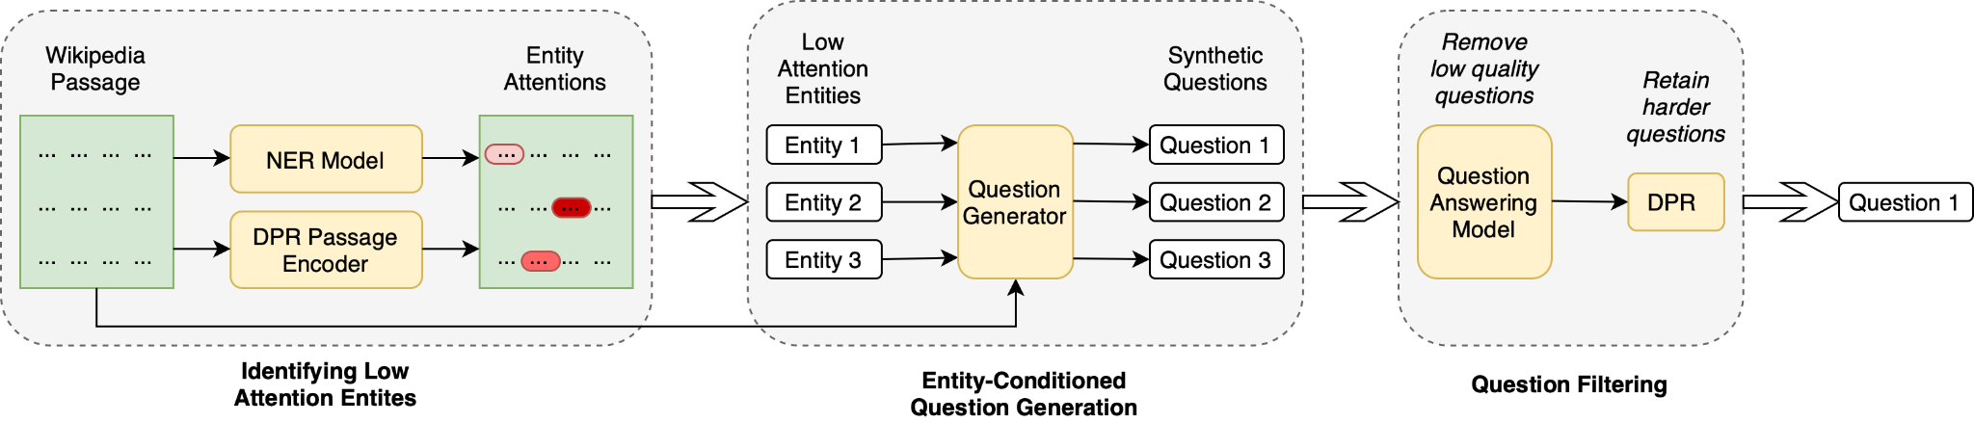
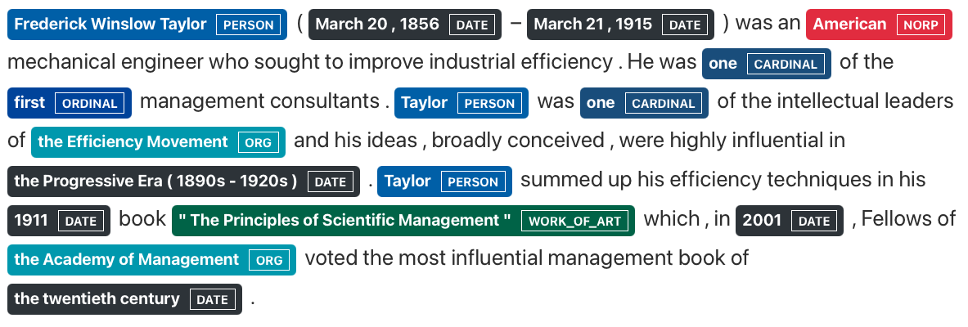
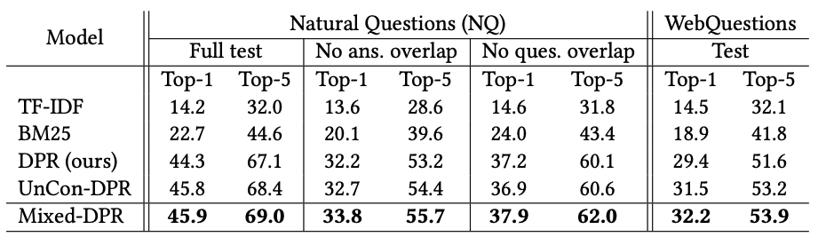
Question Generation
Overall framework of our synthetic data generation process
Conditioned Entity | Generated Synthetic Question
Progressive era | who was considered the father of management during the progressive era
Principles of Scientific Management | who wrote the principles of scientific management
Top-k retrieval results (in %) on test sets of Natural Questions and WebQuestions. Numbers on WebQuestions are in zero-shot settings, since models have been trained on NQ.
Reddy et al. Entity-Conditioned Question Generation for Robust Attention Distribution in Neural Information Retrieval. SIGIR 2022

Slide 6
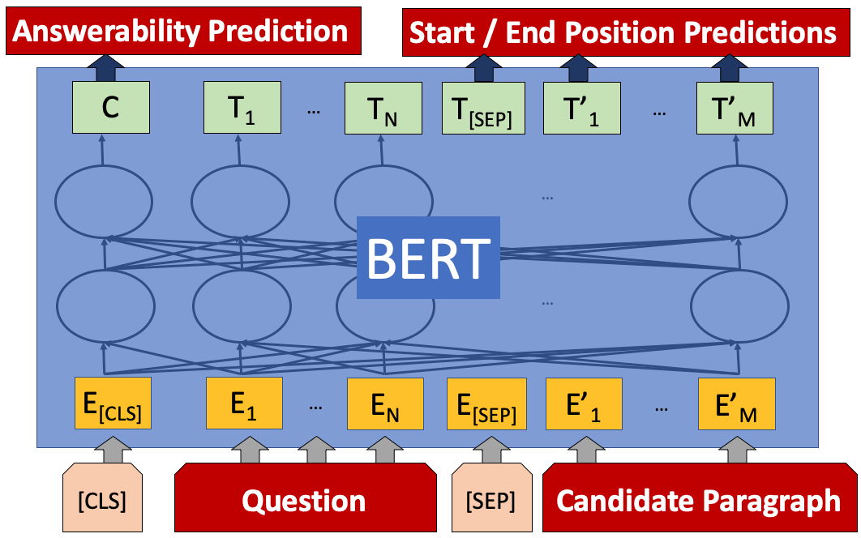

The basic architecture is the same
Add a fine-tuning layer on top of a large pre-trained Language model [Bornea et al., 2021]
833,500
XLM-R
1933 में वारसॉ के कितने निवासियों ने पोलिश भाषा बोली थी?
In 1933, out of 1,178,914 inhabitants 833,500 were of Polish mother tongue. World War II changed the demographics of the city, ...
HINDI
ENGLISH
Notes:
X on Y

Slide 7

Welcome Cecilia ! A new graduate student
Cecilia has taken ML 101, NLP 101 and knows basic QA details.
She has read about: the academic benchmarks for performing QA:
Multilingual Machine Reading Comprehension: TyDI [Clark2019]
Cross-lingual Open Retrieval: XOR-TyDI [Asai2020]
Table QA: WikiSQL [Zhong2017]
Image source: www.phd-comics.com

Slide 8
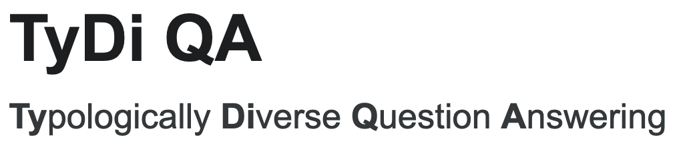
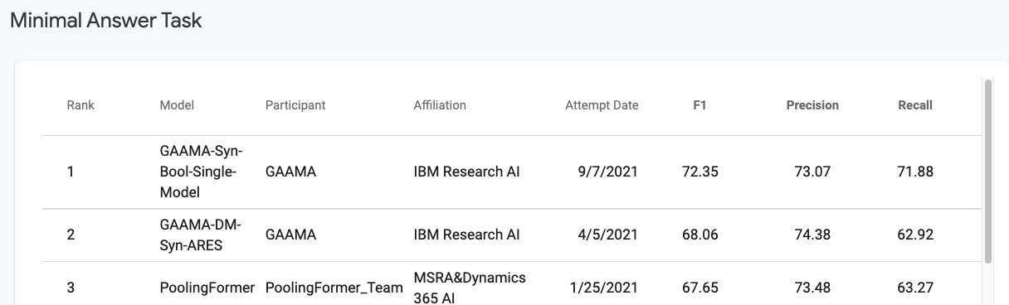
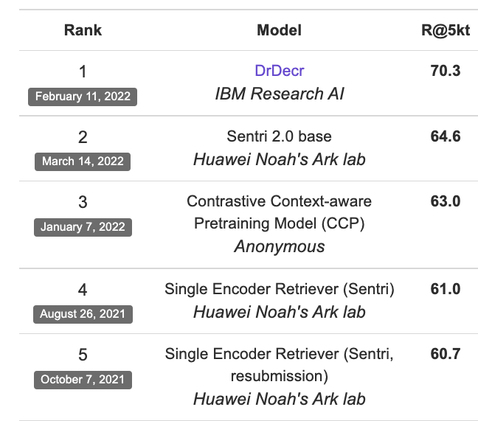

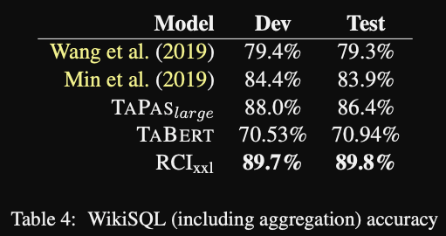
Cecilia does some literature survey!
Cecilia wants to get the latest greatest SOTA models to start with!
She sees the following leaderboards ->
She reads the following papers: SOTA on the tasks
TAPAS --[Herzig2020_ACL] – SOTA on WikiSQL
Dr. Decr -- [Li2022_NAACL, Bornea2020_AAAI]– SOTA on XOR TyDI

Slide 9
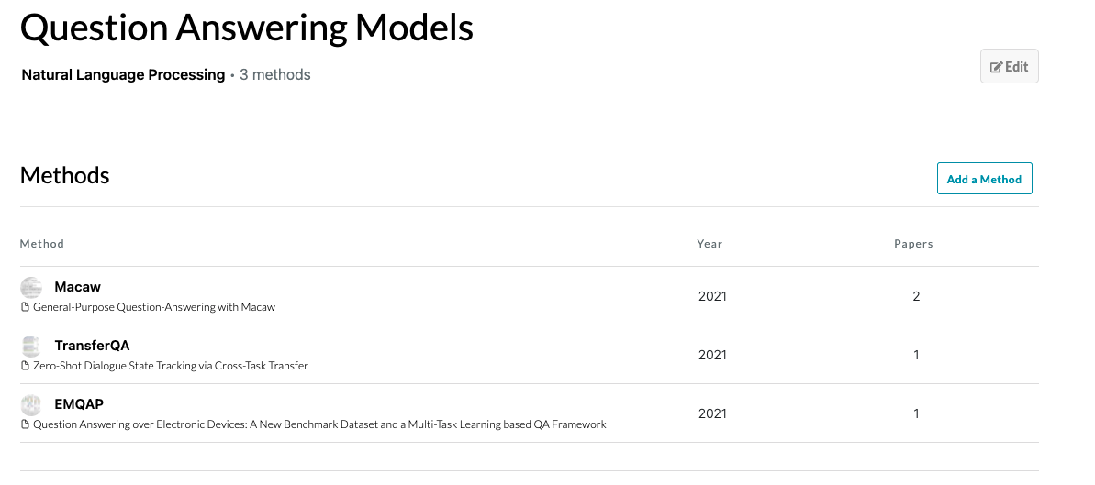


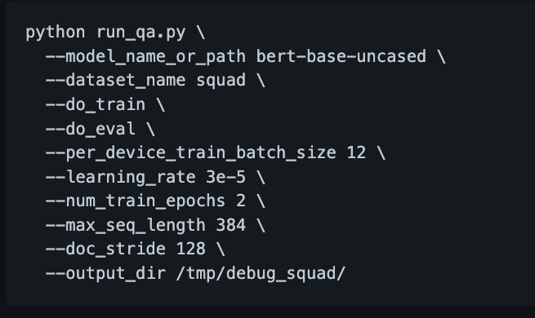
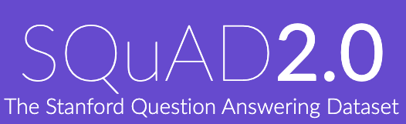
Cecilia looks for the source code to replicate these models
Papers with Code?
What about HuggingFace?

Slide 10
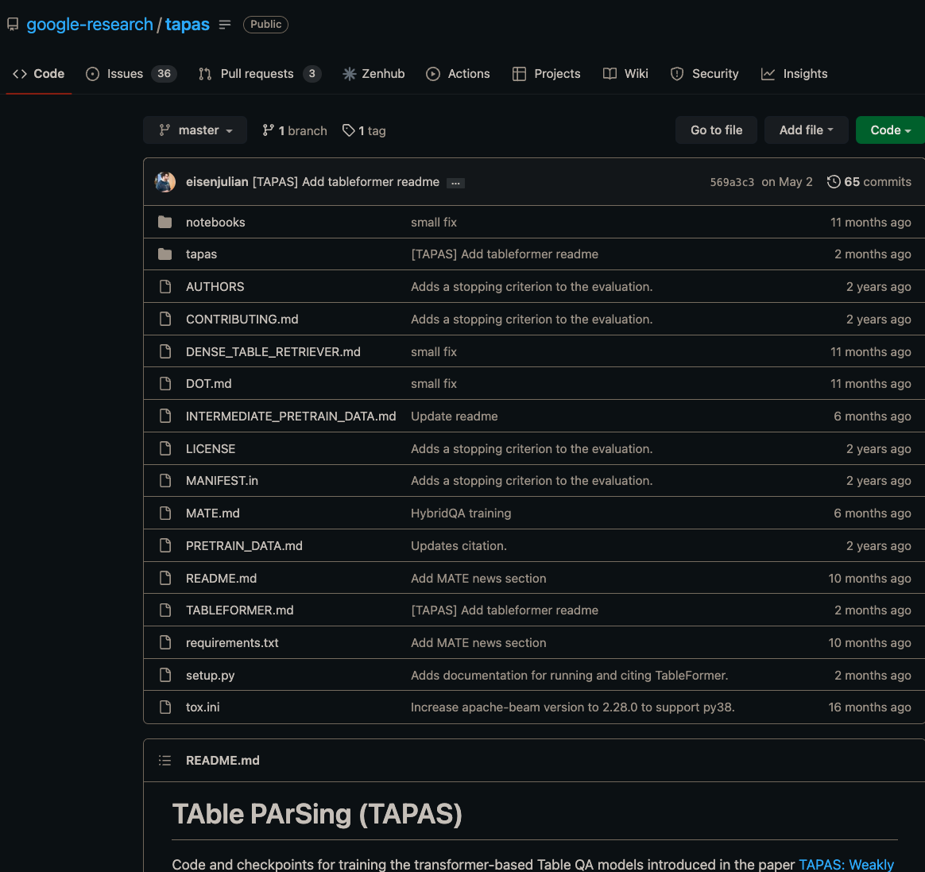

Wait! Cecilia finds the SOTA model’s source code on TableQA
But this is only Table QA: no other QA use-case
No TyDI
No XOR TyDI
No CoLBERT

Slide 11

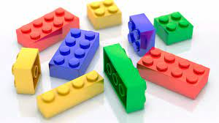
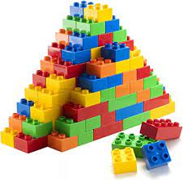



Our Objective: Democratize & Replicate QA research
We need to build a single OPEN-source repository for ALL QA problems
End-user can use them as Lego blocks for QA problems
End-user can modify them as per their own needs
End-user can replicate advanced research papers and leaderboard submissions quickly
IR
Built on top of
TableQA
MRC
Confidence
Calibration
A final end2end QA solution
Lots of stand-alone Github repos
Bring in more repos
An alliance of QA researchers
Notes:
Give the power back to the students

Slide 12
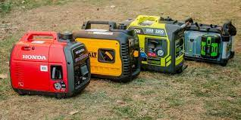

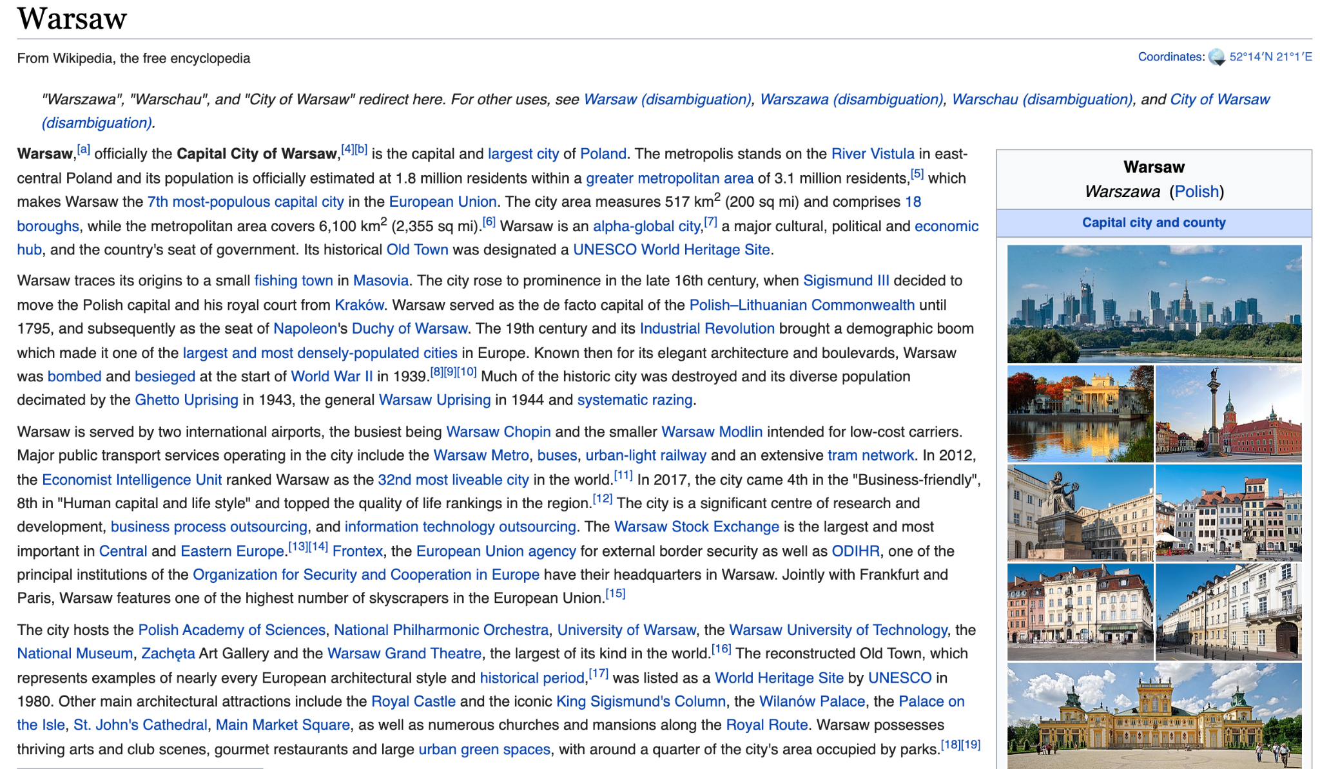
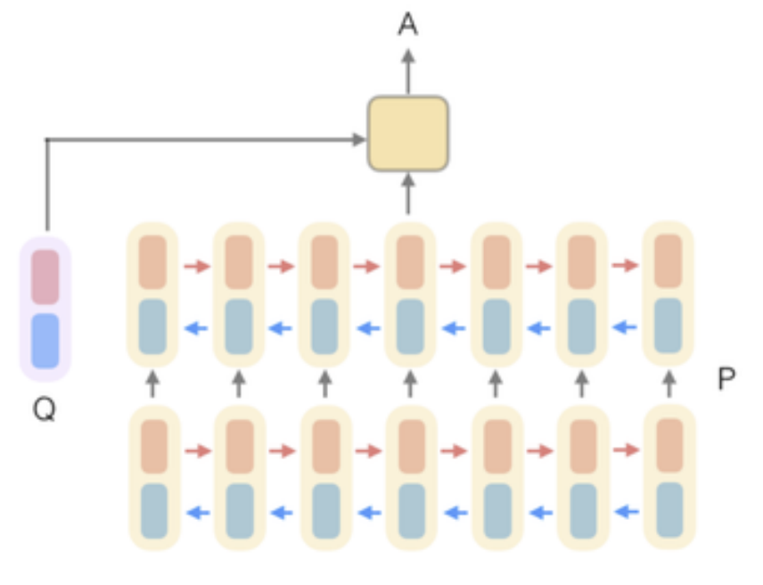
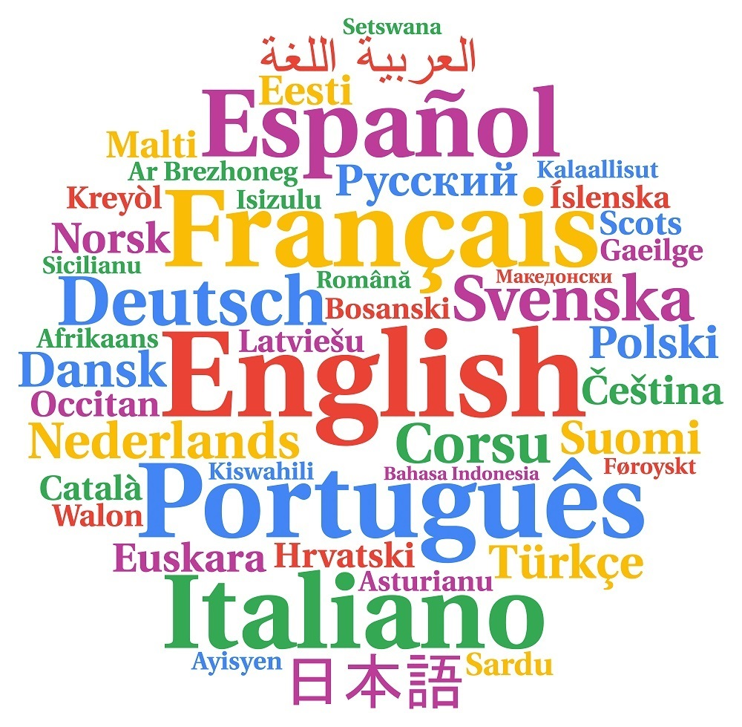
PrimeQA has four basic scripts
Open-Retrieval QA (ORQA)
Question
Generators
run_qg.py
run_qa.py
Q: How many of Warsaw’s inhabitants spoke Polish in 1933?
run_ir.py
General multilingual QG:
Supported Datasets:
SQUAD
Tydi
Table QG
Supported Datasets:
WikiSQL
run_mrc.py
Document Retriever
Document Reader
833,500
BM25
ColBERT
Extractive
With multilingual support!
Pyserini
Supported Datasets:
XOR-TyDI
Multilingual support (Dr.Decr)
Knowledge Distillation
Supported Datasets:
XOR-TyDI
NQ
General MRC (with confidence calibration):
Supported Datasets:
TyDI
NQ
SQuAD v1.0
MLQA
XSQuAD
Special MRC:
Supported Datasets:
Boolean QA
List QA
Notes:
Slide is inspired by: https://github.com/danqi/acl2020-openqa-tutorial/blob/master/slides/part1-introduction.pdf We use the term “open retrieval”—instead of open domain—to refer to models that can access answer context from large document collections. We avoid using open domain due to its double meaning as “covering topics from many domains.

Slide 13
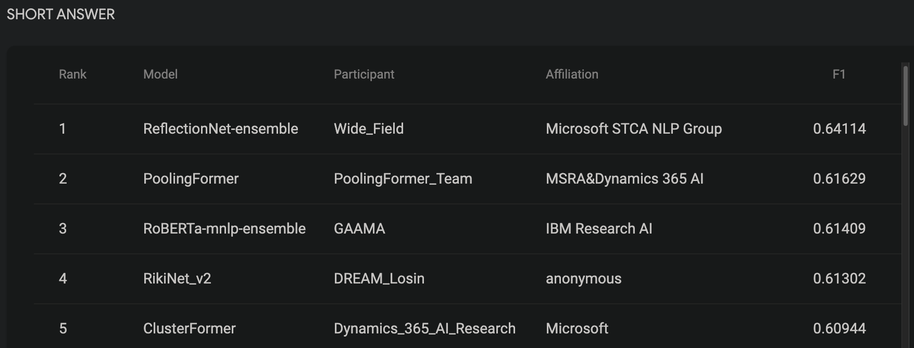
These are leaderboard winners!
Open-Retrieval QA (ORQA)
Question
Generators
run_qg.py
run_qa.py
Q: How many of Warsaw’s inhabitants spoke Polish in 1933?
run_ir.py
General multilingual QG:
Supported Datasets:
SQUAD
Tydi
Table QG
Supported Datasets:
WikiSQL
run_mrc.py
Document Retriever
Document Reader
833,500
BM25
ColBERT
Extractive
Pyserini
Supported Datasets:
XOR-TyDI
Multilingual support (Dr.Decr)
Knowledge Distillation
Supported Datasets:
XOR-TyDI
NQ
General MRC (with confidence calibration):
Supported Datasets:
TyDI
NQ
SQuAD v1.0
MLQA
XSQuAD
Special MRC:
Supported Datasets:
Boolean QA
List QA
Notes:
Slide is inspired by: https://github.com/danqi/acl2020-openqa-tutorial/blob/master/slides/part1-introduction.pdf We use the term “open retrieval”—instead of open domain—to refer to models that can access answer context from large document collections. We avoid using open domain due to its double meaning as “covering topics from many domains.

Slide 14
PrimeQA’s full suite [yellow: indicates available after NAACL release]
Open-Retrieval QA (ORQA)
Question
Generators
run_qg.py
run_qa.py
Q: How many of Warsaw’s inhabitants spoke Polish in 1933?
run_ir.py
General multilingual QG:
Supported Datasets:
SQUAD
Tydi
Table QG
Supported Datasets:
WikiSQL
run_mrc.py
Document Retriever
Document Reader
833,500
BM25
ColBERT
DPR
Extractive
Generative
Multi-modal
Pyserini
Supported Datasets:
XOR-TyDI
Multilingual support (Dr.Decr)
Knowledge Distillation
Supported Datasets:
XOR-TyDI
NQ
Re-implemented to be license friendly
Supported Datasets:
NQ
WoW
General MRC (with confidence calibration):
Supported Datasets:
TyDI
NQ
SQuAD v1.0
MLQA
XSQuAD
Special MRC:
Supported Datasets:
Boolean QA
List QA
General MRC:
Supported Datasets:
NQ (KiLT)
WoW (KiLT)
LFQA (FiD):
Supported Datasets:
ELi5 (KilT)
TableQA:
Supported Datasets:
WikiSQL
WikiTableQuestions
Vision + Text:
Supported Datasets:
MumuQA
Notes:
Slide is inspired by: https://github.com/danqi/acl2020-openqa-tutorial/blob/master/slides/part1-introduction.pdf We use the term “open retrieval”—instead of open domain—to refer to models that can access answer context from large document collections. We avoid using open domain due to its double meaning as “covering topics from many domains.

Slide 15
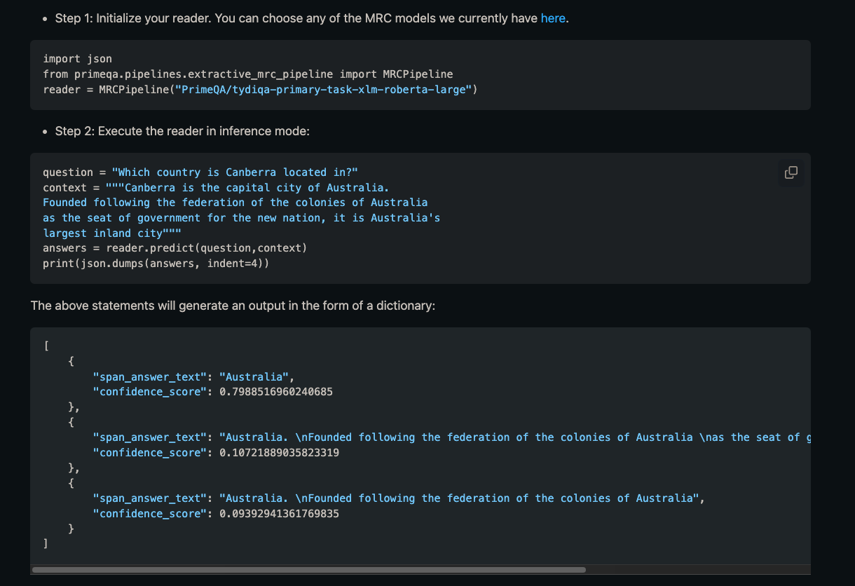
Running MRC (predict mode)
Inference Pipeline
2 PrimeQA imports,
4 lines of code.

Slide 16
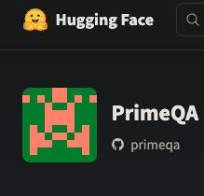
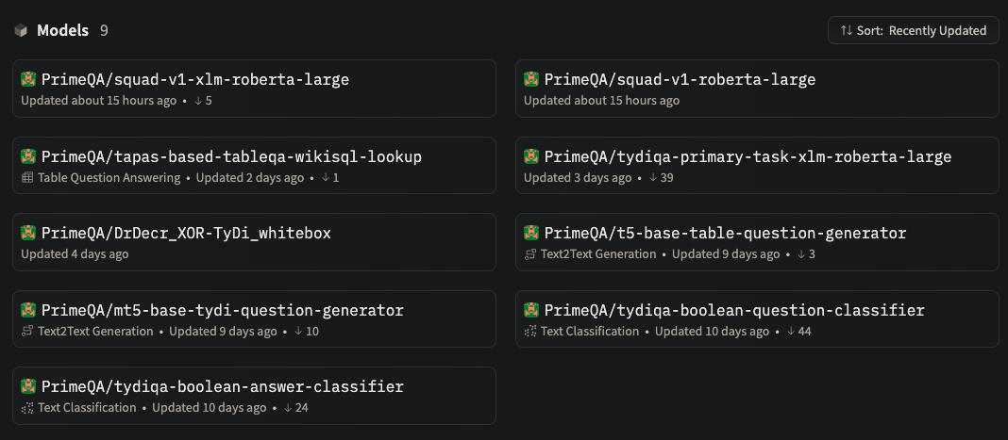


Running MRC (predict mode)
https://huggingface.co/PrimeQA
Swap models from model hub
You can upload your own MRC models for others to use!

Slide 17
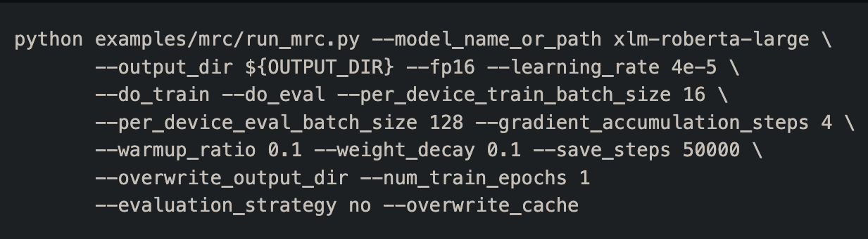
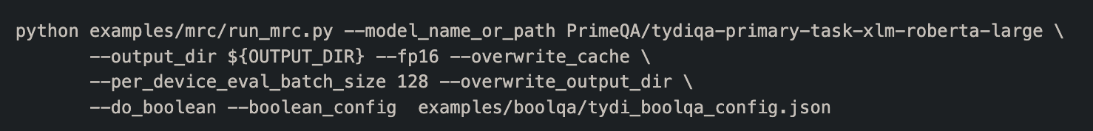
Running MRC (full train + predict)
If your dataset has support for Boolean Questions (e.g. Yes/No) as in TyDI QA you can further run:
Parameter to run Boolean questions

Slide 18
Running IR
Training
Indexing
Search
python examples/ir/run_ir.py
--engine_type ColBERT
--do_index
--compression_level 2
--checkpoint <my_dir>/experiments/<my_expt>/checkpoints/colbert-LAST.dnn
--collection <data_dir>/psgs_w100.tsv
--root <my_dir>/indexes/<my_expt>
--index_root <my_expt>_indroot
English
python examples/ir/run_ir.py
--engine_type ColBERT
--do_train
--doc_maxlen 180
--bsize 192
--accum 6
--maxsteps 20000
--triples <data_dir>/xorqa.train_ir_negs_100_poss_3.tsv
--model_type xlm-roberta-base
--root <my_dir>/experiments
--experiment <my_expt>
python examples/ir/run_ir.py
--engine_type ColBERT
--do_search
--queries <data_dir>/xorqa_dev.tsv
--root <my_dir>/indexes/<my_expt>
--index_name <my_expt>_indname
--checkpoint <my_dir>/experiments/<my_expt>/checkpoints/colbert-LAST.dnn
--collection <data_dir>/psgs_w100.tsv
--experiment <my_expt>
--ranks_fn <my_dir>/experiments/<my_expt>/ranking.tsv

Slide 19
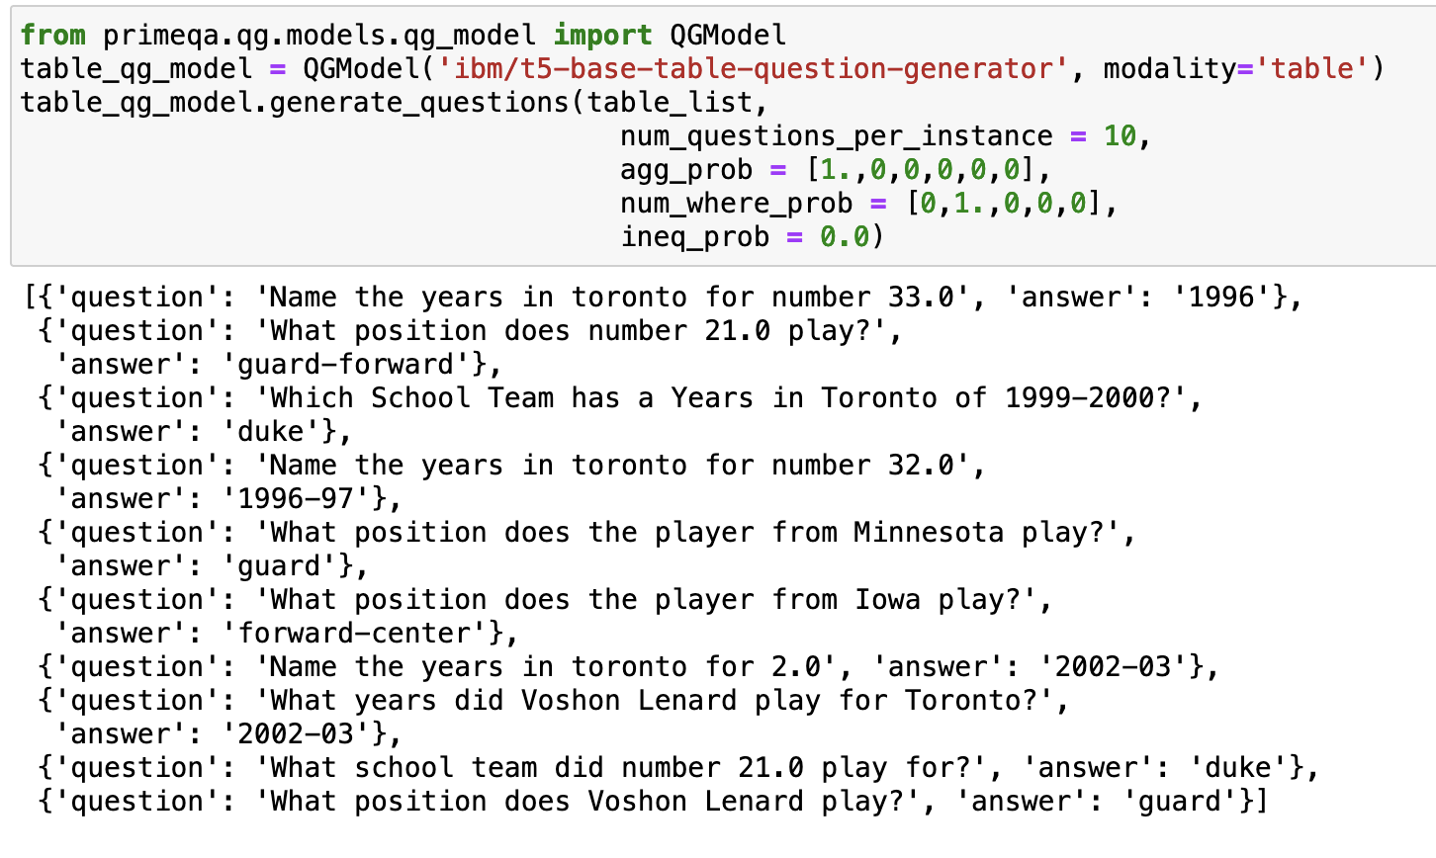
Multilingual Question Generation: Usage
CLI – training and evaluation
Using pretrained QG model in python code
python examples/qg/run_qg.py \
--model_name_or_path t5-base \
--modality passage \
--dataset_name tydiqa \
--do_train \
--do_eval \
--output_dir models/qg/$DIR_NAME \
--learning_rate 0.0001 \
--num_train_epochs 4\
CLI - generation
python examples/qg/run_qg.py \
--model_name_or_path models/qg/wikisql\
--modality table \
--do_generate \
--num_questions_per_instance 20 \
--data_path <path-to-json-file> \
--generate_aggregate \
--max_where_clauses 2 \
--gen_output_path /results/qg/$DIR_NAME
One can use QG over table/passage with only 1 primeqa import and 2 code lines.
PrimeQA/ DOC ID / July 01, 2022 / © 2020 IBM Corporation

Slide 20
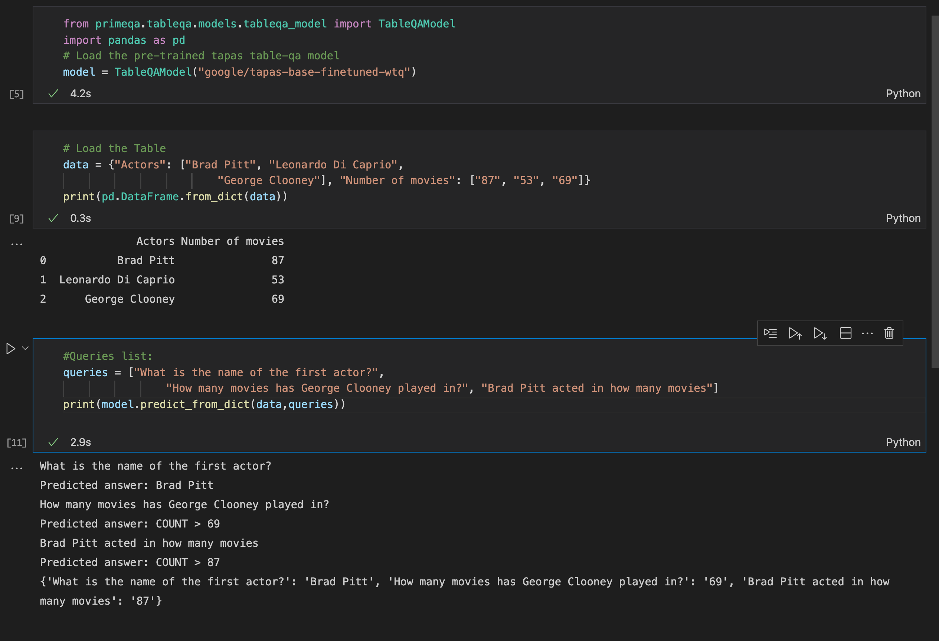
Running TableQA
Inference Pipeline
2 PrimeQA imports,
3 lines of code.
Notes:
ToDos: 1. Train on full WikiSQL data (including aggregations) and make the model available in HF.
2. Linking run_tableqa to run_mrc (in PrimeQA)

Slide 21
Conclusion
To make information access really possible quickly we need to share code and models
Our software needs to be compatible with one another
Let’s work on this together and make QA research move quicker than ever

Slide 22
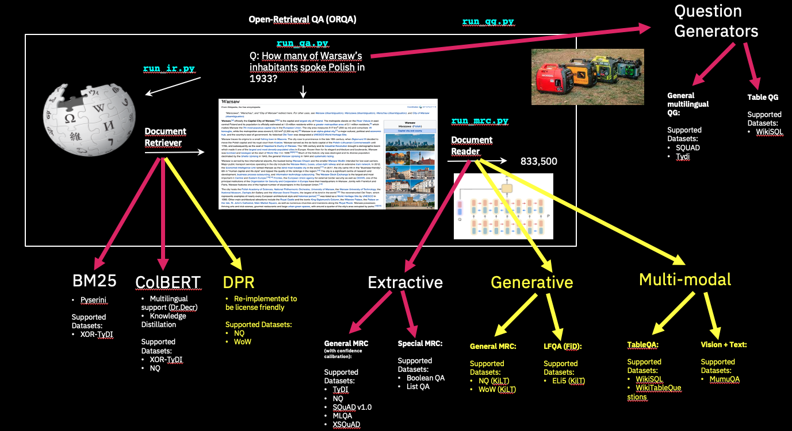
Thank you!
PrimeQA
https://github.com/primeqa/primeqa

